Slide 1
Cell membranes and membrane potential
Foundations of Cellular Neuroscience
FAES
Spring 2016
Travis Hage
hageta@mail.nih.gov

Slide 2
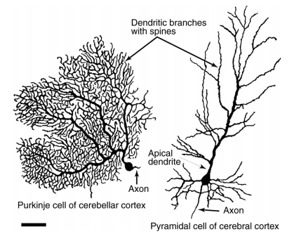
Structure of neurons
Common features of neuronal morphology
Axon
Dendrite
Spines
Soma
Figure 1.1 From Molecules to Networks

Slide 3
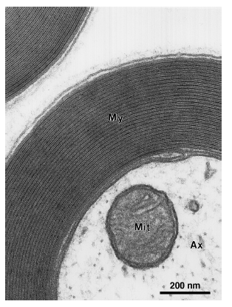
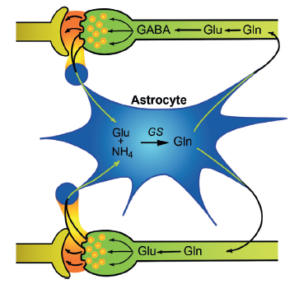
Glia
Glia outnumber neurons
Perform a myriad of important functions related to signal transduction, metabolism, immune response etc.
Read pages 11 – 17 for excellent overview
Figures 1.7 & 1.14

Slide 4
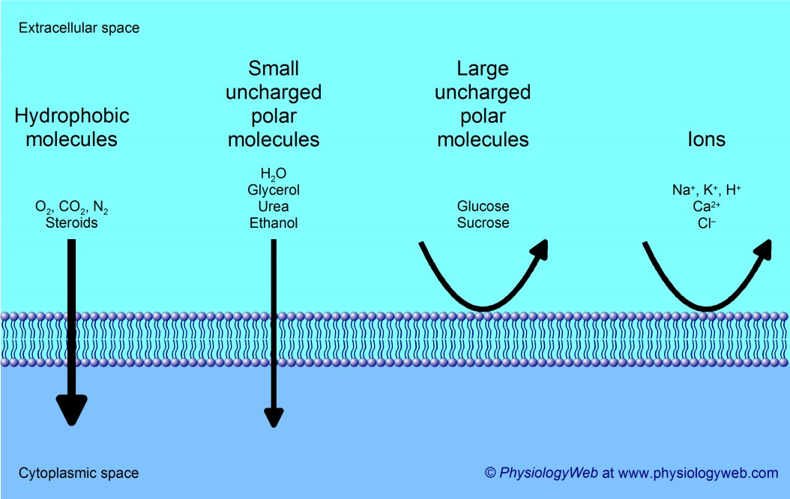
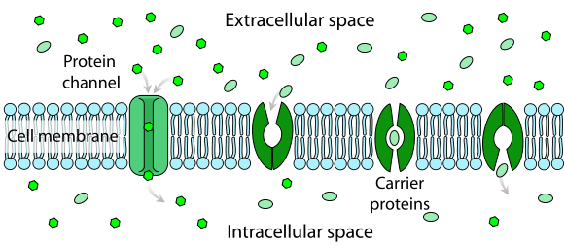
The plasma membrane
wikipedia.org

Slide 5
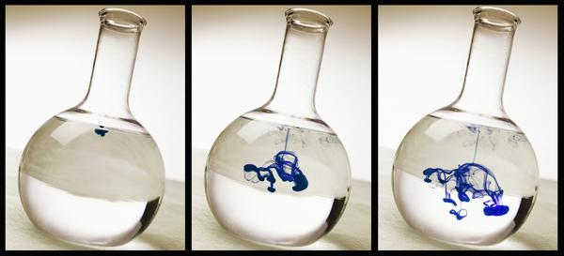
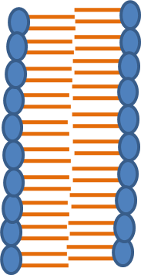

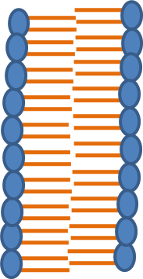
Diffusive force
http://education.seattlepi.com/
an uncharged molecule
What will the system look like at equilibrium?

Slide 6
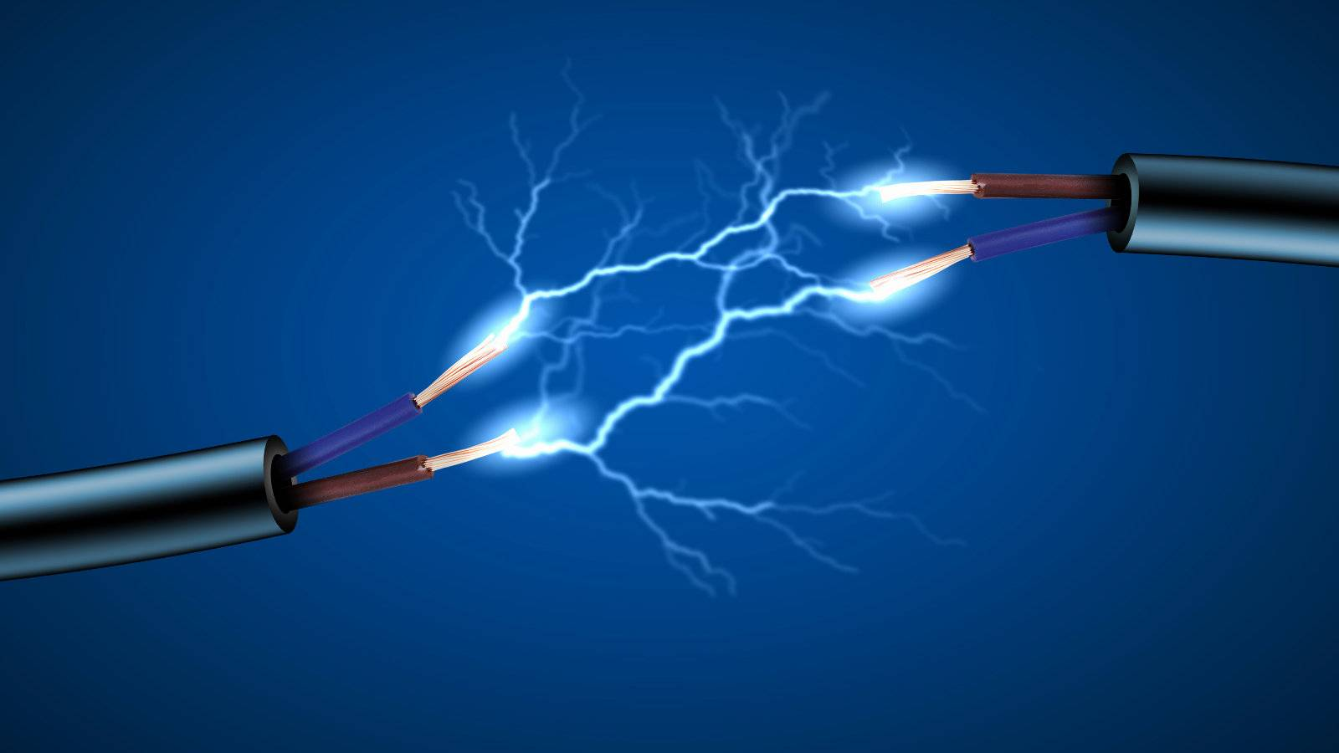
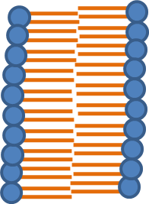
Electrostatic force
-
-
+
+
-
+
-
+
-
+
+
-
+
-
-
+
-
+
-
-
-
+
+
+
-
-
+
+
http://www.gizmodo.in/
-100 mV
If the left side of the membrane has a negative potential (or voltage) relative to the right side, will electrostatic force drive a cation to the left or the right?

Slide 7
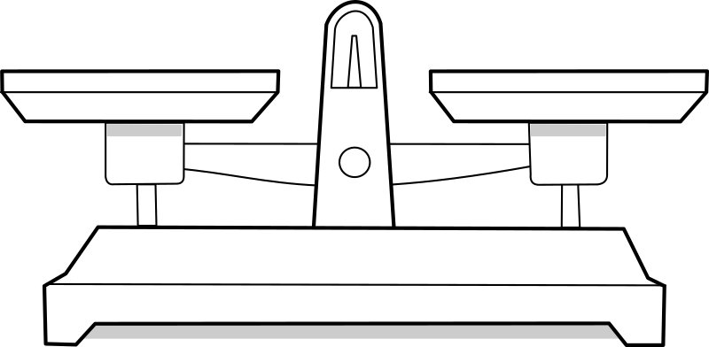
Combining electrostatic and diffusive forces
What happens when there is a concentration gradient of ions?
diffusion
electrostatics

Slide 8
Combining electrostatic and diffusive forces
Imagine a starting condition in which:
[+]_{in} = [-]_{in} and [+]_{out} = [-]_{out}
However,
[+]_{in} > [+]_{out}
Finally, the membrane is only permeable to the positive ion.
What will the system look like at equilibrium?
Will the concentration gradient dissipate?
Will an electrical gradient be established?
intracellular
extracellular
+
-
+
-
+
-
+
-
-
+
+
-
-
-
+
+
-
-
+
+
+
+
-
-
-
-
+
+
+
-
??? mV

Slide 9
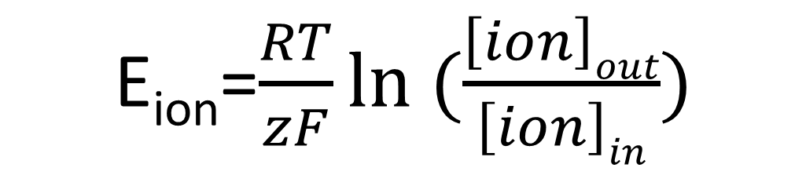
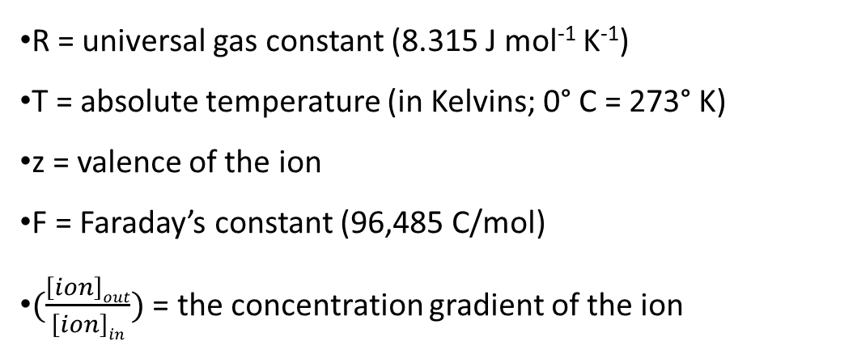
The Nernst equation
Used to find the membrane potential at which the current carried by an ion equals zero or “the equilibrium potential”
R = universal gas constant (8.315 J mol⁻¹ K⁻¹)
T = absolute temperature (in Kelvins; 0° C = 273° K)
z = valence of the ion
F = Faraday’s constant (96,485 C/mol)
$(\frac{\left[ion\right]out}{\left[ion\right]in})$ = the concentration gradient of the ion

Slide 10
The Nernst equation, fun w/o numbers
What is the equilibrium potential for an ion if there is no concentration gradient? Hint: ln(1) = 0
For a cation, is the equilibrium potential positive or negative when [ion]_{out}<[ion]_{in}?
How about when [ion]_{out}>[ion]_{in}?
What about an anion?
What about a divalent ion, like Ca²⁺?

Slide 11
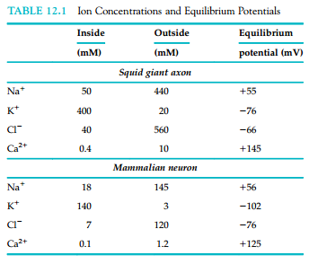
The Nernst equation, fun w/ numbers
For T = 20° C (room temperature) and z = +1:
E_{ion} = 58 log([ion]_{o}/[ion]_{i})
For T = 37° C (body temperature) and z = +1:
E_{ion} = 61.5 log([ion]_{o}/[ion]_{i})

Slide 12
Selective permeability determines the membrane resting potential
extracellular
In the situation illustrated, we have physiological concentration gradients for Na⁺ and K⁺. Furthermore, there are membrane proteins that allow movement of only K⁺ ions across the membrane.
Will there be a voltage across the membrane at equilibrium? Which concentration gradient will determine the voltage?
What if the membrane proteins were blocked or otherwise removed?
If we did not know what ion the membrane was permeable to, but could measure the membrane potential, could we perform an experiment to determine membrane permeability?
K⁺
Na⁺
K⁺
Na⁺
intracellular

Slide 13
Important electrical terms
Charge (q): the physical property of matter that causes it to experience a force when placed in an electromagnetic field. Like charges repel, opposites attract. The common unit for charge is the coulumb (C). 1 mole of electrons or a monovalent ion (like Na⁺) has a charge of 96,495 C.
Current (I): the flow of charge over time. The unit is the Ampere or 1 coulomb/second. We will mostly talk about current across the plasma membrane. Biological currents are fairly small, usually measured in picoamps (10⁻¹² A) or nanoamps (10⁻⁹ A).
The convention regarding sign is that positive current represents cations moving from the inside of the cell to the outside of the cell. Positive current is also described as outward current.
Accordingly, negative current values represent inward current (cations moving from the outside of the cell in).
Potential or Voltage (V): the work required to separate two charges. The unit is the volt (V). Biological membranes typically have a transmembrane voltage of tens of millivolts. By convention, a negative voltage means that the inside of the cell is negative relative to the outside.
-

Slide 14
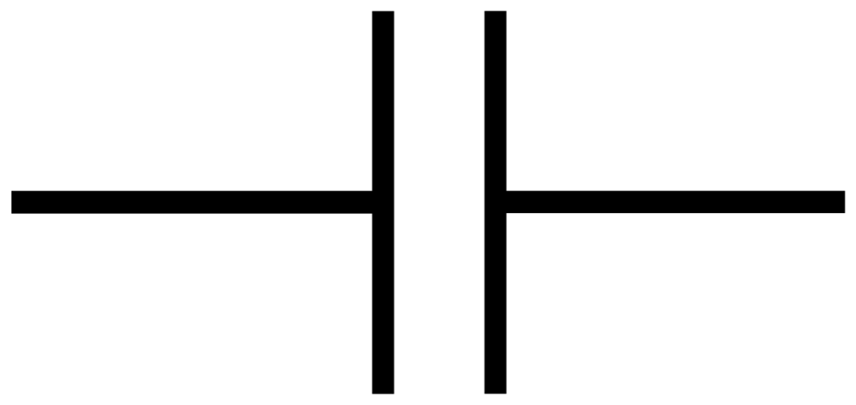
The plasma membrane as a capacitor
Capacitance is the ability to store charge.
Capacitance = charge/voltage
Measured in Farads.
1 Farad = 1 Coulomb/1 Volt
The plasma membrane is a phospholipid bilayer.
The head groups are hydrophilic and interact with charged particles.
The lipid tails are hydrophobic and do not.
This arrangement acts as a parallel plate capacitor. Two surfaces which can carry charge, separated by an electrical insulator.
-
+
-
+
+
-
+
-
+
-
-
+
-
+
-
+
-
+

Slide 15
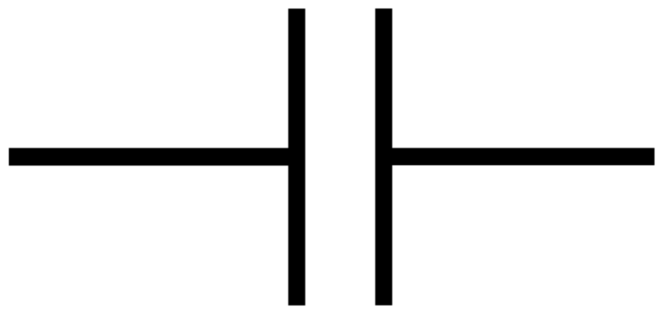
The plasma membrane as a capacitor
For a parallel plate capacitor:
C = ε₀ (K_{d} x a/d)
ε₀ is the permittivity constant (a physical constant describing a vacuum).
K_{d} represents how well charge moves through the insulator relative to a vacuum.
a is the surface area of the plates.
d is the distance between the plates.
Cell membranes have a capacitance of ~1.0 µF/cm². The capacitance of the cell is proportional to the surface area.
-
+
-
+
-
+
-
+
-
+
-
+
-
+
-
+
-
+

Slide 16
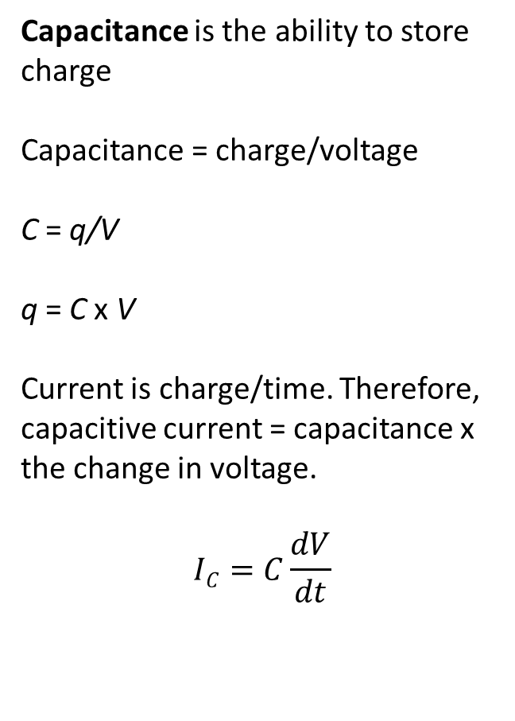
The plasma membrane as a capacitor
Capacitance is the ability to store charge
Capacitance = charge/voltage
C = q/V
q = C x V
Current is charge/time. Therefore, capacitive current = capacitance x the change in voltage.
$$IC=C\frac{dV}{dt}$$
-
+
-
+
+
-
+
-
+
-
-
+
-
+
-
+
-
+

Slide 17
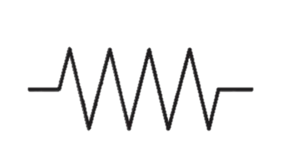
Channels as resistors and Ohm’s law
The ion-selective pores in the membrane are called ion channels.
The ease of current flow between two points is called conductance (g)
According to Ohm’s law, the current between two points is equal to the conductance times the voltage:
I = g x V
Electrical properties are also described in terms of resistance (R) which is the reciprocal of conductance.
By convention, positive current indicates cations moving out of the cell.
Neurons are commonly characterized by their “input resistance” measured by injecting a known current and measuring the voltage response.
intracellular
extracellular
+
-
+
-
+
-
+
-
+
+
-
-
-
+
+
-
-
-
+
+
+
+
-
-
-
-
+
+
+
-

Slide 18
The garden hose analogy
For normal people, electrical resistance is not an intuitive concept.
Imagine a garden hose attached to a faucet.
The water pressure is analogous to voltage, the water current ≈ electrical current and the diameter of the hose ≈ electrical conductance.
I = g x V
How does water pressure effect the amount of water going through the hose?
How does hose diameter effect the amount of water going through the hose?

Slide 19
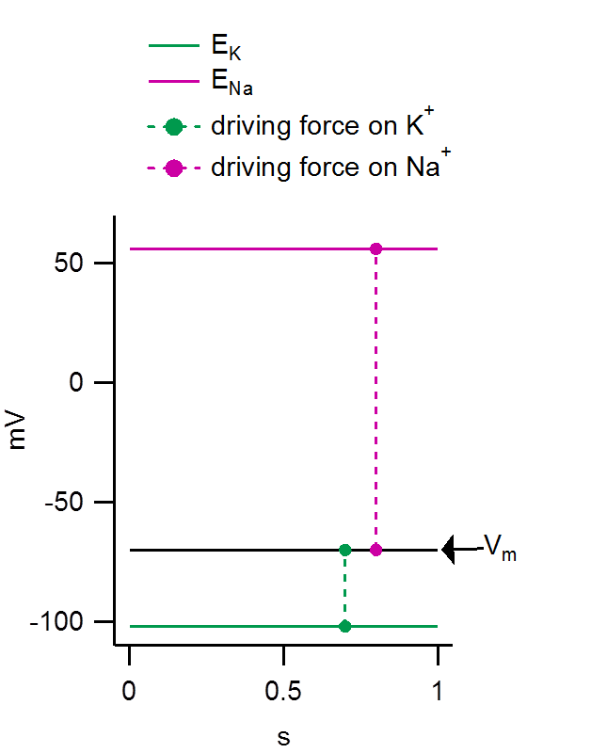
“Driving force” is a measure of the combined electro-chemical forces on an ion
Driving force = V_{m} – E_{ion}
Driving force is the difference between the membrane potential and the equilibrium potential of an ion.
i.e. the difference between where the membrane is and where an ion “wants” it to be.
I = g x (V_{m}-E_{ion})
Under physiological conditions, is the driving force on K⁺ greater at a membrane potential (V_{m}) of -100 mV or +100 mV?
What directions are the driving forces on Na⁺ and K⁺ at V_{m} = 0 mV?

Slide 20
An equivalent circuit of a membrane containing sodium and potassium channels
The total current is equal to the sum of the capacitive and ionic currents
I_{total} = I_{C} + I_{K} + I_{Na}
Figure 14.1

Slide 21
Finding V_{rest} for a membrane permeable to Na⁺ and K⁺
For a cell at rest, I_{K} = - I_{Na}
The driving force on Na⁺ is much larger than the driving force on K⁺. How do the currents have the same magnitude?
g_{K}(V_{m} – E_{K}) = - g_{Na}(V_{m} – E_{Na})

Slide 22
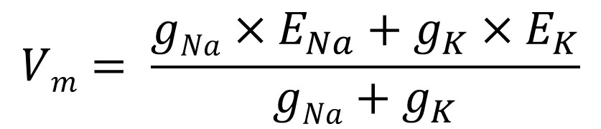
Finding V_{rest} for a membrane permeable to Na⁺ and K⁺
I_{total} = I_{C} + I_{K} + I_{Na}
@ steady-state I_{total} = 0 and dV/dt = 0
0 = I_{K} + I_{Na}
I_{K} = - I_{Na}
g_{K}(V_{m} – E_{K}) = - g_{Na}(V_{m} – E_{Na})
Solve for V_{m}

Slide 23
Fun with the “weighted average” equation
What happens if a membrane does not conduct Na⁺?
What happens if g_{Na} = g_{K}?
Estimate V_{m} if g_{K} = 20 x g_{Na}.
What will happen to V_{m} if g_{Na} dramatically increases?
E_{K} = -102 mV
E_{Na} = +56 mV

Slide 24

The GHK voltage equation
The Goldman Hodgkin Katz voltage equation predicts the membrane potential at steady-state (similar to the weighted average equation). However, the GHK equation is a function of permeabilities and ion concentrations. For a given membrane, each equation will provide similar values. Equation above from Box 12.4.

Slide 25
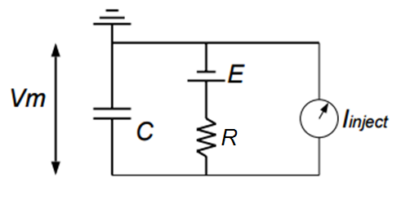
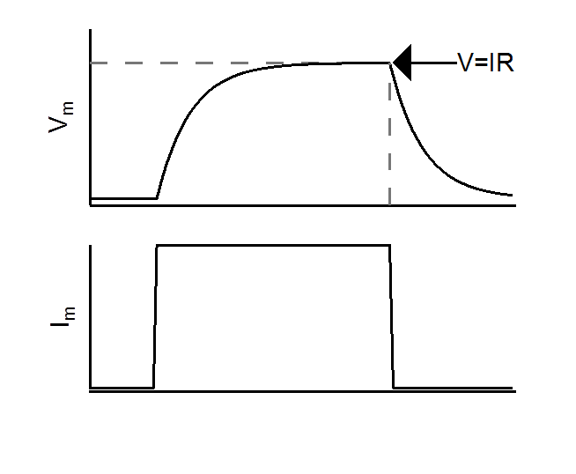
.
An equivalent RC circuit of the membrane
Charging:
V(t) = V∞(1 - e^{-t/τ})
Discharging:
V(t) = V∞e^{-t/τ}
τ (tau) = RC and is also known as the time constant
τ has units of seconds
at t = τ, V_{m} ≈ 2/3 steady-state V
The size of the cell and the membrane resistance influence the speed with which it responds to current injections

Slide 26
.
An equivalent RC circuit of the membrane
What will happen to the size of a voltage response if R increases?
What would an increase in R likely mean for the number of open channels?
Consider two cells with the same R, but cell B is 5 times as large as cell A. Will the voltage response be larger or smaller for cell B? Will the voltage response be faster or slower?

Slide 27
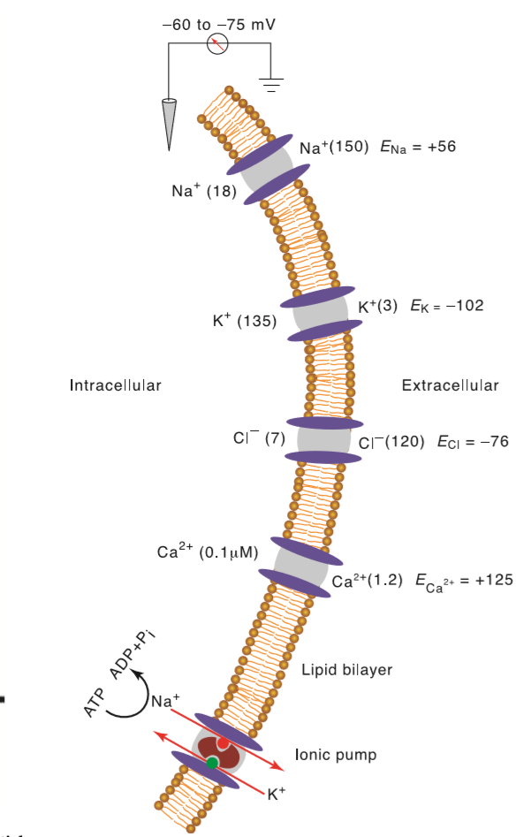
Active membrane pumps help maintain ion concentration gradients
Text pages 356-358 and Chapter 3 for details
Membrane pumps move ions against their electrochemical gradients via hydrolysis of ATP or movement of other ions down their respective gradients (active transport)
Figure 12.2

Slide 28
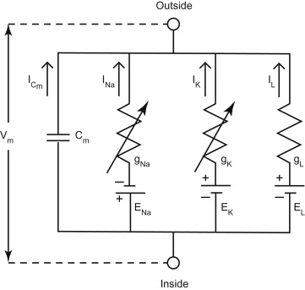
Why should a membrane have multiple conductances?
Even when a membrane is at rest, Na⁺, K⁺, other ions are moving down their electro-chemical gradients.
This has to be maintained by active pumps – very energy intensive (~2/3 of ATP is consumed by Na⁺/K⁺ ATPase in neurons)
Why put up with this?

Slide 29
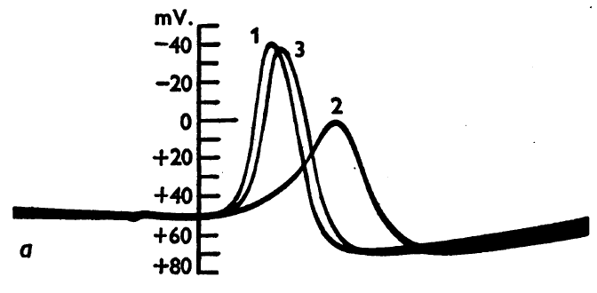
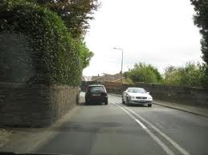
An important note on discussion articles for weeks 2 and 3
Hodgkin & Katz and Hodgkin & Huxley use opposite sign conventions.
These are old-fashioned, long papers. A word-for-word understanding is not expected. Rather, try to appreciate the experimental manipulations, what they are measuring and how this leads to their conclusions.

Slide 30
Membrane and membrane potential key points
2 forces act on ions distributed across biological membranes
The Nernst equation can be used to find when these two forces are balanced
The “driving force” is the difference between the actual membrane potential and the equilibrium potential of an ion
The “weighted average voltage equation” can be used to predict the membrane potential of a membrane permeable to multiple ions at steady state

Slide 31
Office hours?
Email questions to hageta@mail.nih.gov

